Slide 1
HOLOCAUST
Cause and Effect
By David L. Jenson

Slide 2
What was the Primary Cause of the Holocaust?
Anti-Semitism
Prejudice against or hatred of Jews

Slide 3
The Beginnings of Ant-Semitism
Early Christian thought held Jews collectively responsible for the crucifixion of Jesus.
  This became embedded in both Catholic and Protestant theology with terrible consequences for the Jews.
Many centuries of Jewish persecution and exclusion followed.

Slide 4
Anti-Semitism Timeline
(Just a Taste!)
70 CE Beginning of Jewish expulsion from their homeland.
115-117 CE Thousands of Jews killed in Egypt, Cyprus, and Cyrenaica.
132-135 CE 580,000 Jews killed.
167 CE Jews are collectively held accountable for the death of Christ.
418 CE Jews forced to convert to Christianity.
451 CE Execution of Jewish leaders.
898 CE Confiscation of Jewish Property.
1096 CE 5,000 Jews murdered during the First Crusade.

Slide 5
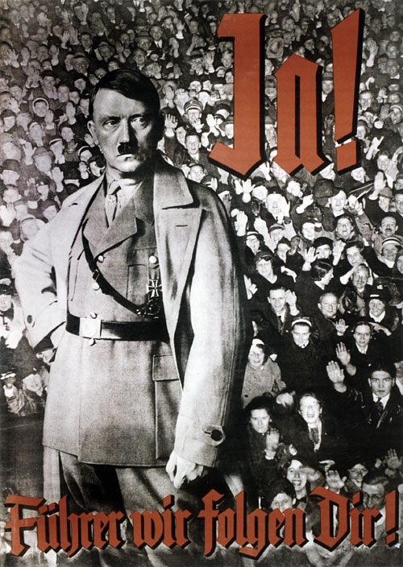
Rise of Hitler and the Nazis

Slide 6
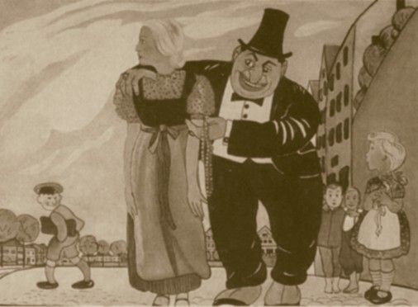
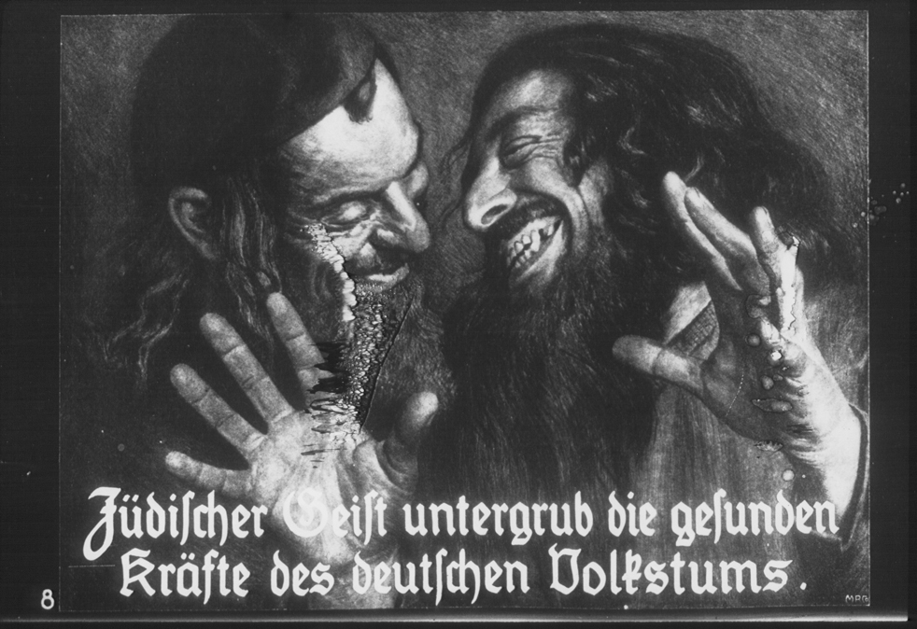
Nazis multiply Anti-Semitism through Propaganda
“When Jewish blood spurts from the knife, things go twice as well”.
-SA celebratory chant
"The Jewish spirit undermines the healthy powers of the German people."

Slide 7
The Holocaust Begins
Inhumanity
Brutality
To the Extreme

Slide 8
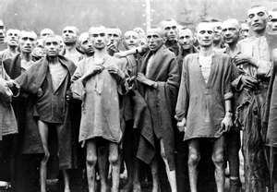
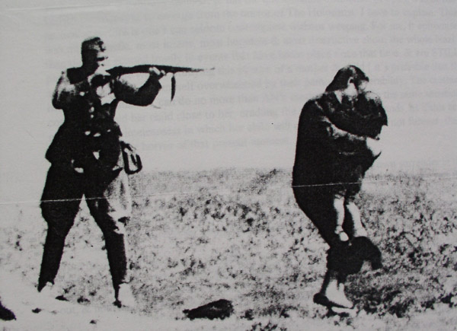
Inhumanity
Brutality

Slide 9
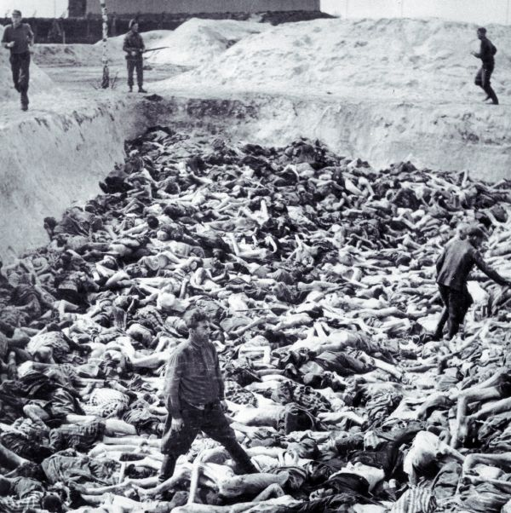
One-Third of the World’s Jewish
Population Killed!
A Grand Total of 6 Million Jews
1.5 Million were Children

Slide 10
Effects of the Holocaust
Was there life after Genocide?
Could the Jews move on after surviving such conditions?

Slide 11
Effects on Individuals
“The Walking Wounded”
Post-Traumatic Stress Disorder (PTSD)
  Flashbacks triggered by sights, sounds, and smells
  Sleep Disturbances
  Memory Lapses
  Emotional Numbing
Mental and Physical Scars
Survivor Guilt
Feelings of Hate or Vengence
Some Remained Trapped in the Past

Slide 12
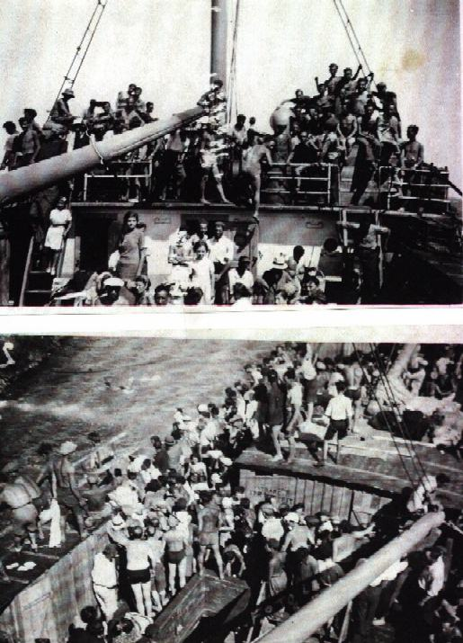
HOLOCAUST REFUGEES
Holocaust survivors had nowhere to go at the time of their liberation. Many were placed in displacement camps while others sought refuge in Palestine or America.

Slide 13
“NEVER AGAIN”
The New Jewish Slogan
“A vow to resist oppression.”
  “They will never again go quietly to the slaughter!”
  “They will fight back however strong the enemy, however hopeless the battle!”
“A pledge to defend human rights everywhere and for everyone.”

Slide 14
The New Jewish State of Israel
In 1947, fueled by their rallying cry “Never Again”, the Jews, Zionist Pioneers and Holocaust Refugees, with the assistance of the newly established UN, successfully establish their own free and sovereign nation.

Slide 15
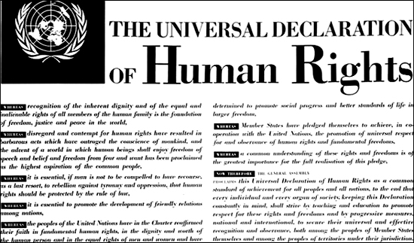

"The plight of the European Jews raised broader issues about human rights". This eventually led to the foundation of the United Nations, its charter, the establishment of an international court, and a Universal Declaration of Human Rights.

Slide 16
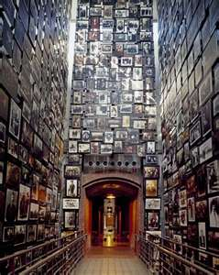
LOST FROM LIVING MEMORY BUT NOT FORGOTTEN!
VAST AMOUNTS OF MEMORIALS, MONUMENTS, MUSEUMS, ARCHIVES, PHOTOS, DOCUMENTS, AND BOOKS HAVE BEEN COLLECTED, BUILT, AND ESTABLISHED SO THAT THE WORLD WILL NEVER FORGET, AND HOPEFULLY NEVER REPEAT, THE HOLOCAUST.

Slide 17
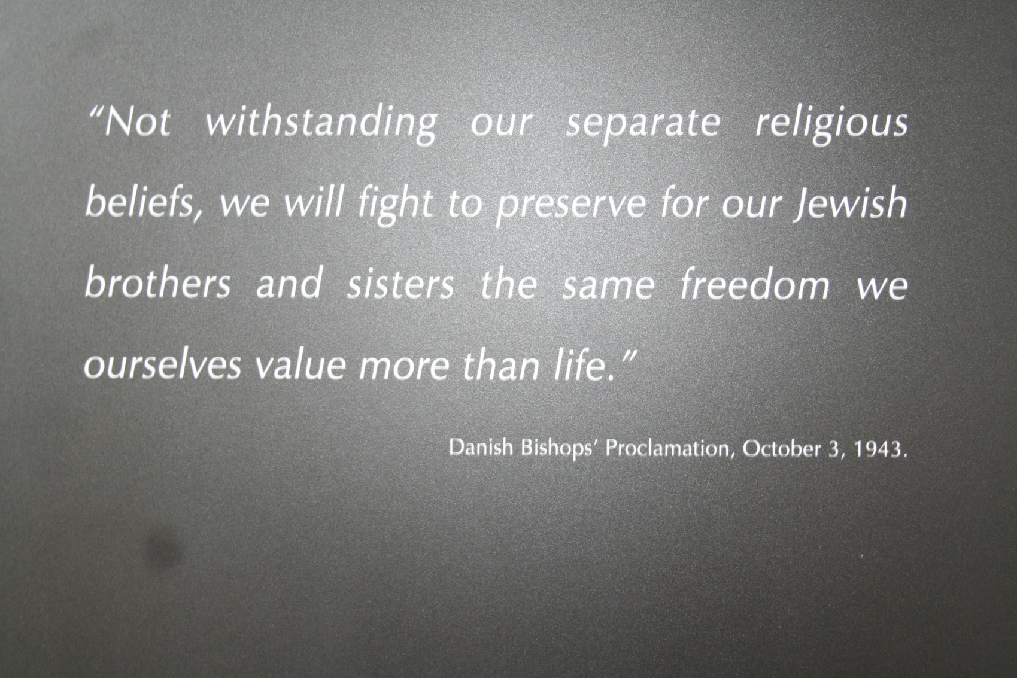
Let us all second this statement and expand it to include all religions, races, and peoples.

